Slide 1
Demystifying AWS EKS clusters creation
for environments with no Internet access
Marcel Hariton
DevOps Engineer at Endava

Slide 2
Amazon EKS
A managed service provided by AWS that make it easier to deploy, manage, and scale containerized applications using Kubernetes on AWS.
Kubernetes Management
Integration with AWS Services
Upgrade and patching
Security
HA and Scalability
Flexibility in node provisioning
Compatibility with K8 ecosystem

Slide 3
Public vs Private EKS
Aspect | Public EKS Cluster | Private EKS Cluster
API Server Access | Exposed to the public internet. | Only accessible within the VPC or through a VPC endpoint.
Security | Requires strict security measures for public internet access. Involves managing network controls, IAM roles, and Kubernetes RBAC. | Inherently more secure due to no direct internet access. Access typically controlled via VPN or Direct Connect.
Network Configuration | Needs configuration of internet gateways, route tables, and security groups for traffic management. | More complex, involving VPC endpoints and VPN
Use Cases | Suitable for development, testing, or applications needing public accessibility. | Preferred for production environments and sensitive workloads requiring strict security and privacy.
Cost Implications | Possible additional costs for data transfer over the public internet. | Potentially higher due to use of AWS PrivateLink.
Maintenance and Management | Generally easier to set up, manage and access. | Requires more advanced AWS and networking expertise for setup and management.

Slide 4













Private EKS Architecture
VPC [us-east-2]
Private subnet (AZ-A)
EKS
NodeGroup
Private ECR
EKS, ECR, EC2, … VPC endpoints
EC2 Instances
S3 VPC state
Private subnet (AZ-B)
Network Load Balancer
User
VPN gateway
EC2 Instances
S3 K8s state
EKS, ECR, EC2, … VPC endpoints
EFS
DynamoDB VPC State Lock
Private subnet (AZ-C)
EC2 Instances
EKS, ECR, EC2, … VPC endpoints
DynamoDB K8s State Lock

Slide 5

State storage in S3
Durability and Reliability
S3 provides highly durable storage, ensuring that the Terraform state is preserved and protected against loss
Centralized management
Storing state files in an S3 bucket allows teams to access the state centrally and securely, which is essential for collaborative environments
Versioning
S3 supports versioning, enabling you to keep a history of your Terraform state files. This can be critical for rolling back changes and understanding infrastructure evolution.
Access Control
Using S3, one can define fine-grained access controls and integrate with AWS IAM to manage who can access the state files

Slide 6
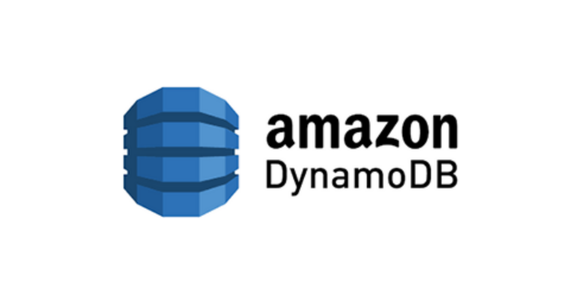
State lock
Locking Mechanism
DynamoDB provides a reliable and efficient locking mechanism with its lightweight and high-performance NoSQL database service.
Concurrency control
It ensures that only one set of Terraform changes can be applied at a time, preventing conflicts
Scalability and HA
DynamoDB offers high scalability and availability, which is beneficial for handling state locking across large and complex infrastructures.

Slide 7

AWS PrivateLink
Requirements
Port 443 TCP must be open for the security group attached to the interface endpoint
For interface endoints:
”private_dns_enabled” should be set to true
“private_dns_only_for_inbound_resolver_endpoint” should be set to false
Required endpoints
com.amazonaws.region.ec2
com.amazonaws.region.s3
com.amazonaws.region.eks
com.amazonaws.region.ecr.api
com.amazonaws.region.ecr.dkr
Optional VPC endpoints
com.amazonaws.region.sts
com.amazonaws.region.logs
com.amazonaws.region.elasticloadbalancing
com.amazonaws.region.elasticfilesystem
com.amazonaws.region.autoscaling

Slide 8
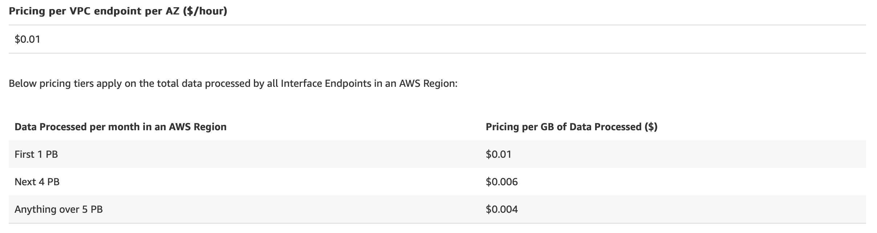
AWS PrivateLink pricing

Slide 9



Private ECR
Pull through cache rules
Allow automatic image caching from a public registry into a private ECR repository
Private registry policies
Permit pull through cache rules to function
EKS
Private ECR

Slide 10
CNI Plugin
Feature/Aspect | Amazon VPC CNI Plugin | Calico
Network Model | Integrates directly with AWS VPC, assigning an IP address from the VPC to each pod. | Uses a standard CNI network model, supporting both overlay and non-overlay networks.
IP Address Management | Each pod gets an IP address from the VPC, potentially consuming a large number of IP addresses in large clusters. | More efficient IP address usage as it can use a smaller range of IPs for a large number of pods.
Performance | High network performance by leveraging native VPC networking. No additional overlay network overhead. | Good performance, but can vary based on whether an overlay network is used or not.
Scalability | Limited by the number of IP addresses available in the subnet. Might require careful subnet planning for large clusters. | Highly scalable, especially with the use of Calico's IP address management capabilities.
Security Features | Basic security features, primarily relies on AWS security groups. | Advanced network security features, including network policies for fine-grained control over pod communication.
Integration with AWS Services | Deep integration with AWS services, leveraging native VPC features. | Basic integration with AWS. More focused on cross-platform capabilities.
Ease of Setup and Management | Simple to set up in an AWS environment, as it is the default CNI for EKS. | Requires additional configuration and management, especially for network policies.
Use Cases | Ideal for use cases that require native VPC features and high network performance. Best for clusters that are not expected to exhaust VPC IP resources. | Suitable for environments that require advanced network security policies and efficient IP management. Good for multi-cloud or hybrid cloud setups.

Slide 11


Persistence
Feature | AWS EBS (Elastic Block Store) | AWS EFS (Elastic File System)
Storage Type | Block-level storage | File storage (NFS)
Use Cases | Single pod access applications like databases (MySQL, PostgreSQL); High-performance requirements | Shared file storage for multiple pods; Applications needing concurrent access.
Scalability | Fixed size; needs manual resizing | Automatically scales with stored data
Performance | High-performance, especially with provisioned IOPS for intensive I/O | Good for file operations, but generally lower I/O throughput and latency compared to EBS
Access and Mounting | Single-node attachment (Multi-Attach in same AZ only for io1/io2); Limited number of EBS-es can be attached to a node | Multi-node attachment; Can be mounted on multiple instances across Availability Zones
Data Durability and Availability | High, but limited to a single Availability Zone (unless replicated) | Highly durable and available, spans multiple Availability Zones
Pricing | Based on provisioned storage size | Based on the amount of storage used

Slide 12
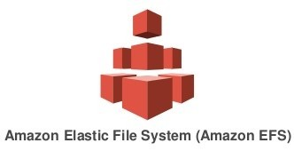
Persistence cont.
Requirements
AWS PrivateLink endpoint for EFS must be present in all private subnets
EFS must be created prior to EFS CSI Driver deployment and FS id must be known upfront
IAM role with “arn:aws:iam::aws:policy/service-role/AmazonEFSCSIDriverPolicy” attached
Traffic to and from port TCP 2049 should be allowed on worker nodes

Slide 13
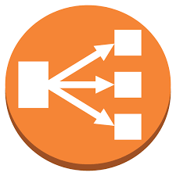

Ingress controller
ALB
Good integration with AWS services
Free SSL termination
Can be used privately but only as a L7 loadbalancer
No caching of static content
Nginx + NLB
Can balance both L4 and L7 traffic
Will have to use cert-manager for certificates

Slide 14

Monitoring and observability
Performance metrics
Track performance of EKS cluster: CPU, memory and network utilization
Application health
Allows to understand the state of applications running on EKS
Logs aggregation
Testers or analysts can have access logs from running pods in real time
Alerting and notifications
Trigger alerts when the deployed application is unhealthy or
Compliance and security
Helps detect suspicious activity and potential breaches

Slide 15
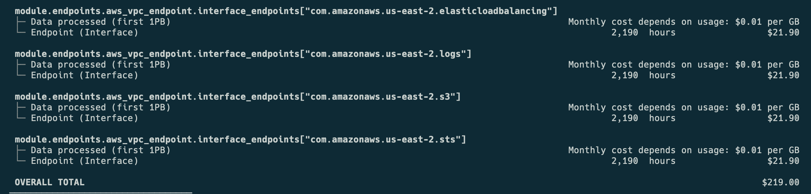
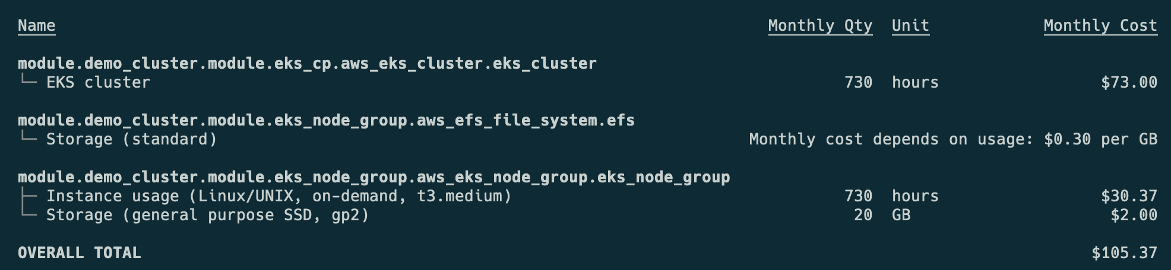
Costs considerations

Slide 16


Slide 17
References
https://github.com/littlemarcel/private-eks [URL to the Terraform code]
https://github.com/infracost/infracost [A tool that lets one asses the infrastructure costs based on a TF configuration]
https://docs.aws.amazon.com/eks/latest/userguide/what-is-eks.html [EKS general docs]
https://docs.aws.amazon.com/eks/latest/userguide/vpc-interface-endpoints.html [AWS PrivateLink docs]
https://github.com/awslabs/amazon-eks-ami/blob/master/files/max-pods-calculator.sh [Maximum number of pods/instance type]

